Slide 1


Rishabh Software
Guide: Mr. Kshitij Tripathi
I42 Vraj Kotwala
I43 Jayati Goswami

Slide 2

Internship Summary
Guide at Rishabh Software: Mr. Gagan Dubey
How Rishabh Software is different?

Slide 3


Domain
A project based on AI and Machine Learning

Slide 4


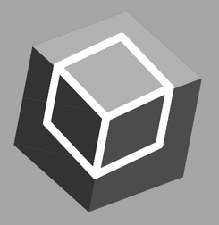

Project Definition
EmotiBot - Emotion Recognition Bot
The project aims to classify the emotion on a person's face into one of the seven categories, using deep convolution neural networks.

Slide 5

Scope
Recognize face (multiple faces) from camera input
Recognize Emotions from 7 classifications:
Angry, Sad, Happy, Disgusted, Fearful, Neutral, Surprised
Provides Accuracy and Logs with Graphics Interface
Save logs into database for further analysis.

Slide 6


Tools & Technology used
Anaconda (Virtual Env.)
Jupyter for testing
PyCharm for development
MySQL
Libraries in python 3:
tkinter
openCV
Numpy (arrays)
Statsmodels
matplotlib
Tensorflow, Keras

Slide 7


Agile Methodology
Agile software development comprises various approaches to software development under which requirements and solutions evolve through the collaborative effort.

Slide 8



What we learnt from Udemy?
What is Data-Science?
What is ML?
Probability
Inferential Statistics
Advance Statistics in python
Regression & Cluster analysis in sklearn
Matplotlib & statsmodels
Matrices & Tensors
Deep Learning and Neural Networks using Tensorflow

Slide 9


Implementation

Slide 10

Master Algorithm
First, we use **haar cascade** to detect faces in each frame of the video. We use this to collect data.
The region of image containing the face is resized to **48 x 48** and is passed as input to the ConvNet. This is to train the model.
Again, we use **haar cascade** to capture faces in each frame from web cam. The network outputs a list of **softmax scores** for the seven classes.
The emotion with maximum score is displayed on the screen.

Slide 11
Vraj Kotwala
Jayati Goswami
Work distribution on his side
Work distribution on her side
Collect Data
Data Preprocessing
Study of papers & courses from Udemy
Collect Data
GUI in Tkinter
Collection of data from various sources.
Like YouTube, Google images, Kaggle, etc.
Gray-scaling images for faster processing of data.
Resizing images for making coding easy and accurate.
Collection of data from various sources.
Graphical User Interface, window menu. For easy Interaction.
Tkinter GUI toolkit for
python 3.
Plannig to switch to PyQt in future.
Data-Science with python.
Study of exsisting systems.
Data Preprocessing
Cleaning of noisy data.
Statistical Classification
Classification
Classification of data images into 7 groups:
Angry, Sad, Happy, Disgusted, Fearful, Neutral, Surprised
Error finding using Confusion Matrix
Improving Accuracy
Data Seperation
80% Train data.
20% Test data.
Will try to improve model for >90% accuracy
Designing Algorithm
GUI integration
Database Modelling
integration of GUI with openCV
Using CNN in Tensorflow.
Database Connection
Research Paper
Probably MySQL.
How does your product or service fit into the grandscheme of things?
Storing logs into database for further analysis.

Slide 12

Ingredients of Training Algorithm
Data
Collection of Dataset.
Model
Create a model. Find some coefficients. A model, loosely speaking, is a simplification of some thing or process.
Objective Function
This function, taking data and model parameters as arguments, can be evaluated to return a number. Classification and cross entropy.
Optimization Algorithm
a function that minimizes an error or one that maximizes reward over punishment. By using Adam Algorithm.

Slide 13
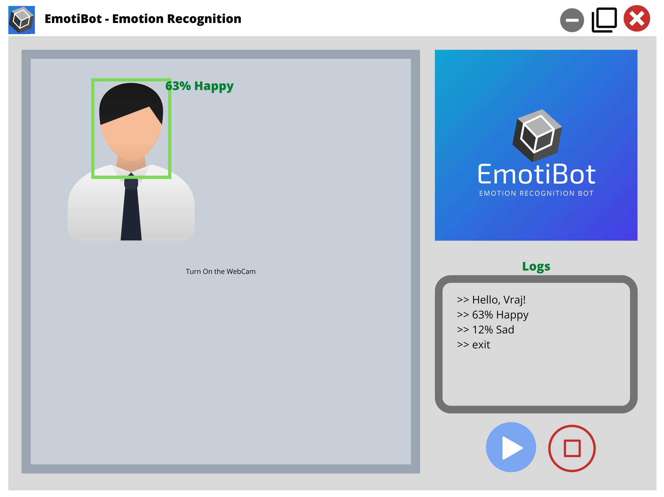
Demo GUI

Slide 14

Work done till date
Data Collection Code
Data Preprocessing
Classification
GUI
Basic Training of model

Slide 15
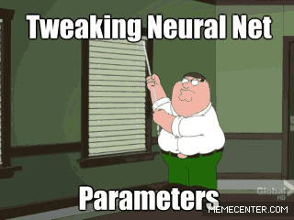

Slide 16



Improvising Accuracy & GUI integration
March End
Future Roadmap
DB modelling & connection
Mid April
Research Paper
April End

Slide 17

Thank You
I42 Vraj Kotwala
I43 Jayati Goswami

